Slide 1
Entertainer data analysis

Slide 2
introduction
In today’s fast-paced world, normal life can often be stressful and demanding. People regularly seek ways to unwind and find relief from their daily pressures. One effective way to achieve this is through entertainment, which provides a valuable escape from routine and helps to alleviate stress.
The entertainment industry plays a crucial role in this regard. It encompasses a wide range of media and activities designed to captivate and engage audiences. From films and television shows to radio programs and print media, entertainment offers a diverse array of options that cater to various tastes and preferences.

Slide 3

In this presentation, we will explore the different segments of the entertainment industry, including:
Segments of the Entertainment Industry:
Film: How movies and cinema shape our experiences.
Television: The role of TV shows in our daily lives.
Radio: The influence of radio programming.
Print Media: The impact of newspapers, magazines, and books.
Challenges and Trends
Current trends in the entertainment industry.
Challenges faced by the industry (e.g., digital transformation, competition).
Future outlook.

Slide 4

The Mass Media
Definition and scope of mass media.
How mass media companies control distribution and production.
Examples of major companies in the industry.
Components of Entertainment Media
Movies: Major studios, genres, and popular films.
TV Shows: Types of shows, networks, and popular series.
Radio: Types of radio shows, famous stations, and impact.
Print Media: Major publications, their reach, and influence.

Slide 5
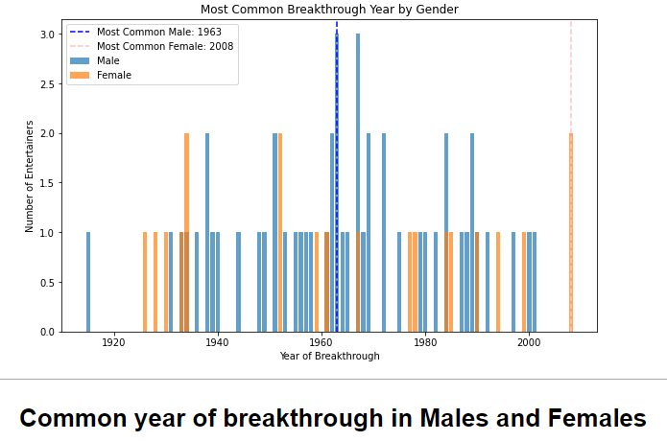
My analysis and graphs

Slide 6
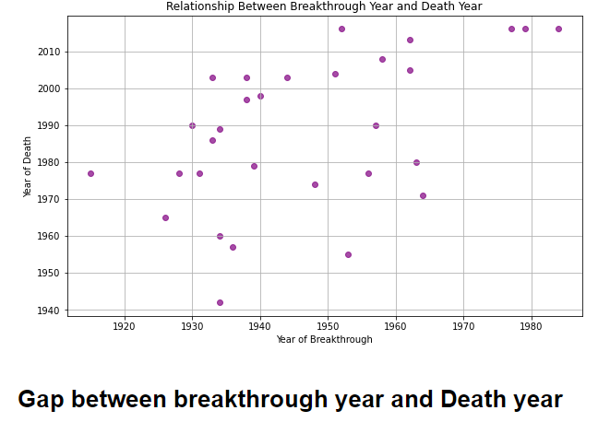
My analysis and graphs

Slide 7
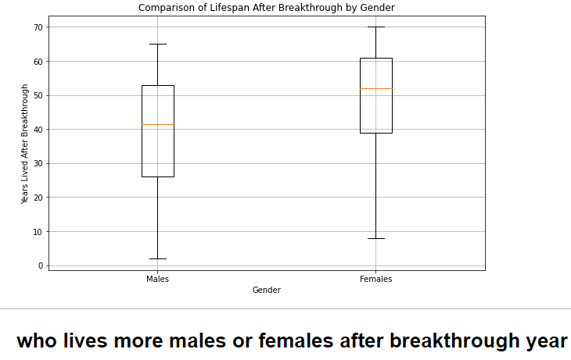
My analysis and graphs

Slide 8
Thank you

